Slide 1



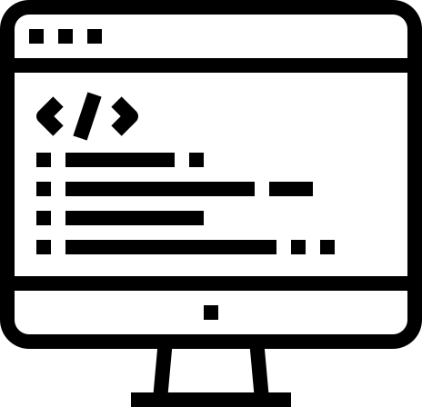
TEAM BITS & BYTES
Banking System
B&B Banking
1

Slide 2
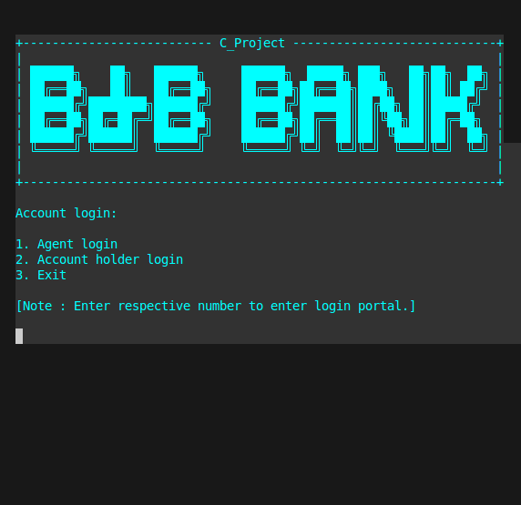
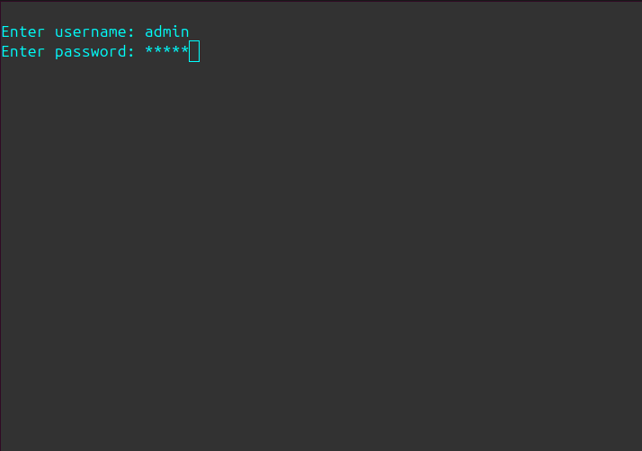
About Project
This project focuses on creating a simple banking system using C programming. The system allows users to perform various banking operations, including account management, secure login, and financial transactions.
Importance
A banking system is crucial for managing financial transactions, ensuring security, and providing users with a reliable way to handle their finances.
2

Slide 3
Account Management:
Create new account holders, admin accounts. and delete account holder accounts as needed.
Secure Login:
Implementation of secure login for both account holders and admins to protect sensitive information.
Key Features
Financial Transactions:
Functions for depositing and withdrawing money from accounts and also transfer balance between accounts.
Account Details Viewing:
Admin functionalities to view account holders' details for management purposes.
3

Slide 4

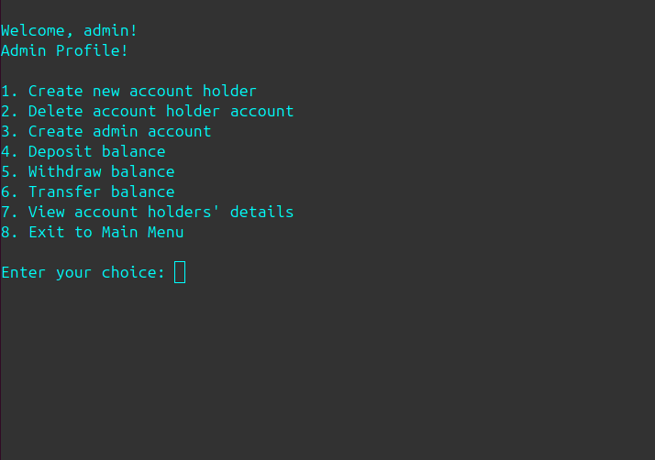
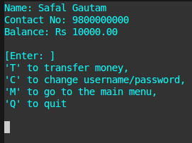
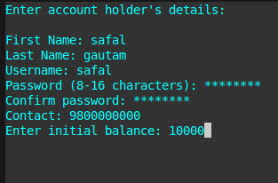
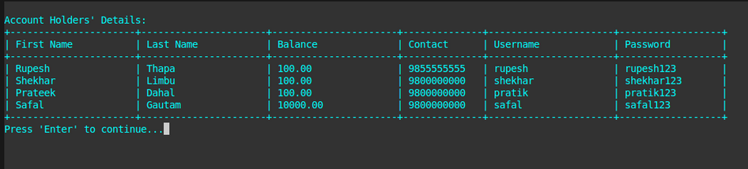
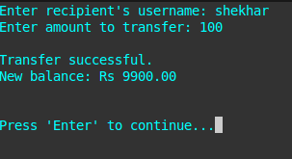
landing page
3. Account holder profile
2. Admin profile
5. Account holder details viewing
6. Balance transfer
4
4. Account creation

Slide 5

Conclusion
Successfully developed a functional banking system using C.
Implemented key features like user authentication, deposits, withdrawals, and admin controls.
Enhanced our programming, debugging, and system design skills.
Overcame challenges through teamwork and problem-solving.
Thank You!
Special Thanks to our team members for their dedication and hard work!
Team Bits & Bytes
Safal Gautam
Pratik Dahal
Shekhar Limbu
Rupesh Thapa
5

Slide 6
Questions Expected:
Why did we choose banking system as our project?
What kind of problems and consequences we faced during our project?
How did we change font color and background color?
Explain password masking.
Explain headerfile used in project.
How did we create header file “Utilities.h”?
Explain why is project for all O.S.
How can we implement these project in our life?
6

